Slide 1
LocalAreaDensity = 0.5, PotentialRadius= 56

Slide 2




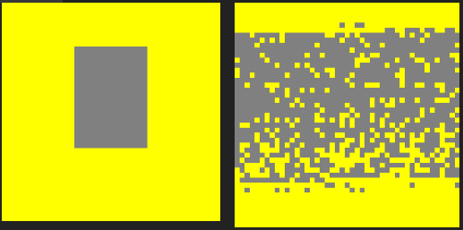

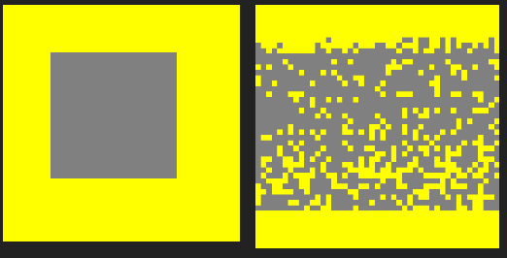
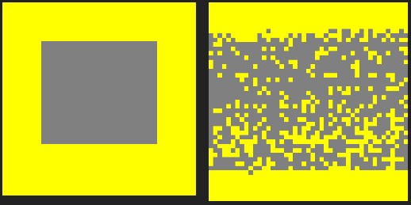


LocalAreaDensity = 0.5, PotentialRadius= 56
I-00 I-01 I-02 I-03 I-04
I-05 I-06 I-07 I-08 I-09

Slide 3
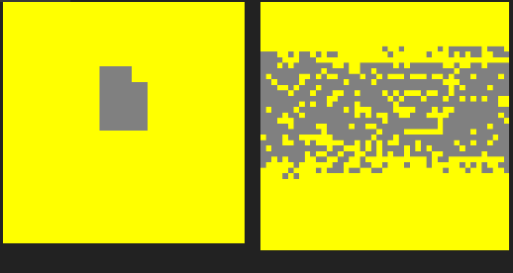
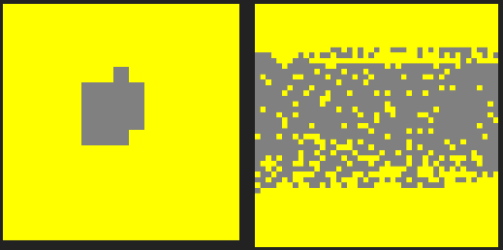


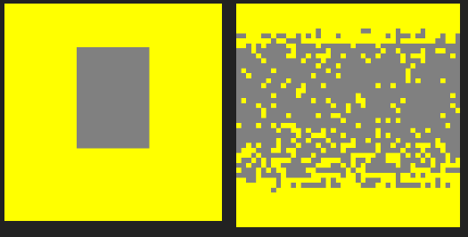




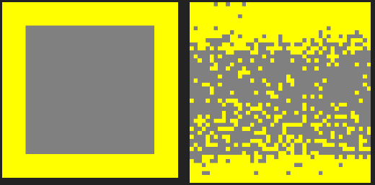
LocalAreaDensity = 0.5, PotentialRadius= 67
I-00 I-01 I-02 I-03 I-04
I-05 I-06 I-07 I-08 I-09

Slide 4

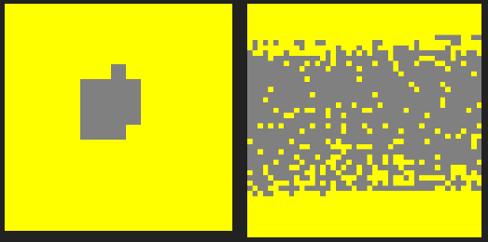







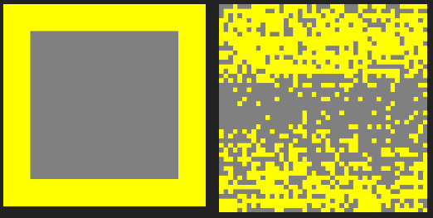
LocalAreaDensity = 0.5, PotentialRadius= 90
I-00 I-01 I-02 I-03 I-04
I-05 I-06 I-07 I-08 I-09

Slide 5







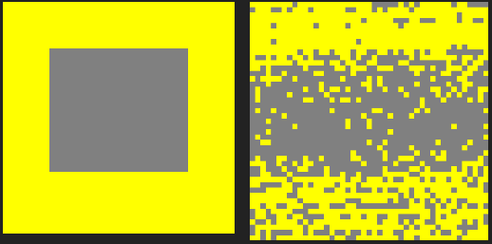
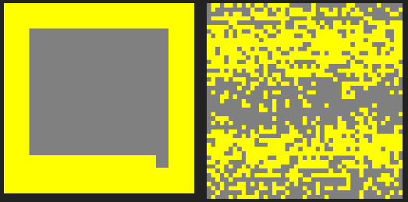
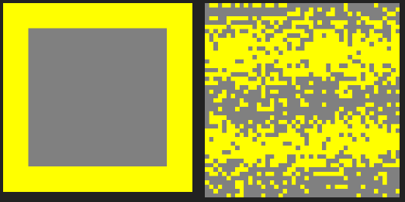
LocalAreaDensity = 0.5, PotentialRadius= 101
I-00 I-01 I-02 I-03 I-04
I-05 I-06 I-07 I-08 I-09

